Slide 1
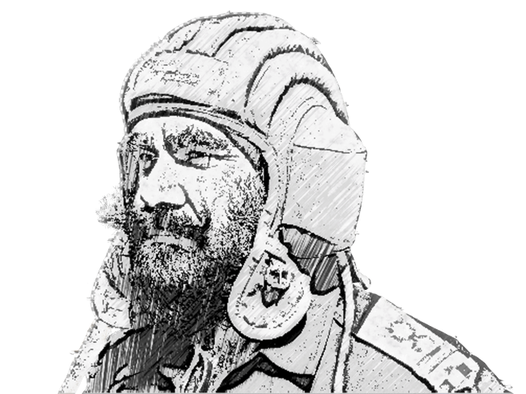

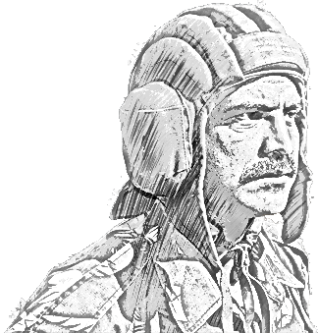
SCHOOL OF TECH TRG
ELECTRONICS WING

Slide 2
INTRODUCTION

Slide 3
AIM
Iss sabaq ka aim method of inasturtion ke bare mein class ko jankari hasil karana hai.

Slide 4
SCOPE
▪ NIYAM
▪ SIDHANT
▪ AIM
▪ PLANNING
▪ INTEREST
▪ USE OF SENSE
▪ ACTIVITY
▪ SIMPLICITY
▪ HUMAN FACTOR
▪ CONFIRMATION

Slide 5
NIYAM
Achchi Sikhlai ke Do Bare Niyam.
Instr ko lesson ka knowledge.
Class ko sikhane ki chahat.

Slide 6
SIDHANT
▪ Aim
Iss period mein mai kya haasil karna chahta hun.
Kis ko parha raha hun.
Subject ko parane ki jarurat kyon.
Diye hue samay par parah sakta hun ya nahin.

Slide 7
AIM KI QISMEN
Immediate Aim. Kisi bhi cadre ko uske lakshy tak pahunchana. Saaf aur chhota hona chahiye.
Ultimate Aim. Yeh sena ki har sikhlai se sambandhit hai. Iska uddesh sainik acharan ko yudh aur shanti kaal mein apni safalta ke yogya banaya hai.
Aim Plus. Iss uddesh mein sainik sikhlai ke saath sainikon ke sainik acharan ko barhane ki koshish karna.

Slide 8
PLANNING AND PREPRATION
Zaruri saamaan.
Place.
Prabandh(arrangement).
Students.

Slide 9
ZARURI SAAMAAN
Library
Achchi
Pamphlets
Lesson Plan
Trg store
Eqpt
Trg aids
Charts
Model
Poster
Board
Study
Room
Alag se
Room
Syllabus
Block Syl
Details Syl
Work Chart
Check Sheet
Trg pgm
Planer

Slide 10
PLACE
Indoor Dekhane aur sunane mein koi badha nahi. Rosani. Baitane ka prabandh. Dress. Water. Badhyen:– poster & picture, sore nahi hona chahie. | Outdoor Railway line. Kuen, Talaab. Band ya Beguiler. Training range. Suvidhaen. Sun light opposite. Sitting arrangement of weather. Drinking water. Dress. Tea brake trg pgm mein samil. Aane aur jaane ka samay.

Slide 11
ARRANGEMENT
▪ Aane/jaane ke praband.
▪ Class ki location ka chuno.
▪ Zarurat ke mutabiq working party.
▪ Demo.
▪ Extra duty off.
▪ Food and water.
▪ Sports and entertainment.
▪ Arrangement of class room.

Slide 12
STUDENTS
▪ Distribution of class in Sqd for good control and sprit.
▪ Sqd distribution to student knowledge.
▪ Sqd banane ki riti students ko pata nahi hona chahie.
▪ Entrance test, sujh bujh Sqd banane mein madad deti hai.

Slide 13
PREPARATION
Taiyari tarteeb se honi chahie.
Lesson ke masalen ko dhundna.
Achchhi tarah prabandh.
Kant chhant karke usse tarteeb mein lagane ko taiyari kahte hain.

Slide 14
LESSON KE MISAL KO DHUNDNA
Kitabon se.
Course ke notes.
Pamphlet.
Apna anubhav.

Slide 15
PARHNA
Hard part in the subject must be know in details.
Make small notes during study.

Slide 16
KANT CHHANT
▪ Kisi bhi subject ke baare mein class ko dhyan mein rakhte hue kant chhant karni chahiye.
▪ Kya jaanna jaruri hai - Must Know.
▪ Kya jaanna chahiye - Should Know.
▪ Kya jaan sakte hain - Could Know.
▪ Kya jaanna jauri hain - woh parhana chahiye.
▪ Kya jaanna chahiye - samay dekh kar parhna chahiye.
▪ Kya jaan sakte hain - samay aur hain toh parhana chahiye.

Slide 17
TARTEEB MEIN LAGANA
Kant chhant karke usse tarteeb mein lagaya jaata hai.
Shuru ka Bhag. Class ki jaanch, prabandh,
dohrai, uddesh aur prastavana shamil hai.
Madhya Bhag. Iss mein path ko bhagon mein banta jaata hai.
Bhag ko parhana.
Sanka(confirmation) aur prashan puchhana.
Bhag ki revision ya abhyas karana.
Bhag ka sarans batana(sum up).
Agle bhag se jorna.(Link up with next bhag)

Slide 18
TARTEEB MEIN LAGANA
Antim Bhag.
Class ko question karne ka mauka do.
Class se question karo.(Final conf)
Sarans poore lesson ka lo.
Question poore lesson mein se lo.
Agle path se jorna(link up with next lesson).
Samay ki Bant.
Explanation - 10%
Demo - 25 %
Prac - 65%

Slide 19
INTEREST
Before Trg. Trg pgme/ Notice Board, Posters.
During trg.
Reality
Bhinn bhinn sadhanon ka paryog.
Lalach.
Phal prapti ki bhavna.
Hansi mazak.
End of trg. Likhit prasan, abhyas, ex.

Slide 20
USE OF SENSE
Sunai Dene Wale Sadhan.
Dhawani pradarshan yantar.
Gramophone and tap record.
Wastvik dhwani.
Dikhai dene wale sadhan.
Sparsh sambandhit sadhan.
Chakhne aur sunghe jaane wale yantra.
Chart.
Board.

Slide 21
ACTIVITY
▪ Sikhlai ke Question.
▪ Jaanch ke Question.
Instructor ki Taraf se Prashan.
▪ Sawaal saaf ho.
▪ Sawaal ke do matlab na nikalen.
▪ Sawaal unchi awaaj mein bolo.
▪ Sawaal poori class se kiya jaye aur jawab ek se puchhana chahiye.
▪ Jawab lete samay bhasha ka dhiyan mat karo.
▪ Adhe adhe sawaal mat puchho.
▪ Question kisi vishes tarteeb se mat puchho.

Slide 22
ACTIVITY
ACTIVITY
Class ki Taraf se Sawaal.
Class ko sawaal puchhane ka mauqa do.
Sawaal karne wala khara hokar unchi awaaj mein sawaal karega.
Sawaal agar thik na ho toh dobara sabdon mein thik karwao.
Puchhe gae sawaal ko class mein dohrao aur yakin karo kih sawaal thik samaj liya hai.

Slide 23
SIMPLICITY
Achchha Instr woh hai jo saral bhasha mein kathin subject rakhta ho. Class ka standard ke anusaar hi bhasa, sadhanon ko pradarshan karte hue student ko dikhata hai aur samajhata hai.

Slide 24
HUMAN FACTOR
▪ Instructor ke gunn.
Chal Dhal.
Josh.
Awaaj.
Bolne ka Dhang.
Shahan Silta.
Hansi Mazak.
Hawbhav.
▪ Class ke Saath Bartav.
Class ko Jaanana.
Dusre Ustad ke Parati Nishtha.
Friendship.
Drasthata.
Pakshpat.
Ghanishtata.
Tarkana
Ding Marna.

Slide 25
CONFIRMATION
Class sadha chust rahti hai.
Yah pata chalta hai ki sabaq kitna yaad ho gaya hai.
Class ko apni safalta ka pata chalta hai.
Note:-
Maukhik.
Likhit.

Slide 26
CONFIRMATION
Pariksha banate samay dhyan mein rakhane wali baaten.
Sawaal poore parhae gaye sabaq mein se ho.
Na hi kathin ho aur na hi aasaan.
Jo parhaya gaya hai usi mein se hona chahie.
Numbering ke liye aasaan ho.

Slide 27
CONFIRMATION
CONFIRMATION
Pariksha ka aim aur subject student ko pahle batana.
Yah koshish ki student pariksha se dharen nahi.
Question paper kisi ko na maalum hona chahie.
Paper dekhkar jaldi number bata dene chahie.
Numbering ke baad paper par bad vibad hona chahie.

Slide 28

JAI HIND!

